Slide 1
TRAINING SEMINAR
ISSB CANDIDATES of PMA L/C

Slide 3
INTRODUCTION

Slide 4
Introduction
Pak Army is branch of the Pakistan Armed Forces responsible for land-based military operations
It came into existence after the partition of sub continent in 1947
Currently headed by General Raheel Sharif
It is a volunteer force having active force of approx 550,000

Slide 5
Introduction
Induction in Pak Army as Commissioned Officer is done through conduct of tests conducted in various stages
Indls qualifying in Prelim exam and found medically fit are subsequently called for ISSB
ISSB constitute various tests to gauge both mental and physical abilities of potential candidates
ISSB test are conducted at three different locations including:-
Kohat
Gujranwala
Malir (Karachi)

Slide 6
Aim
To provide guidance to candidates of PMA L/C for optimum performance at ISSB

Slide 7
Sequence
Overview of Pakistan Army
Requirements at ISSB
Arrival Timings
Documents to be taken along
Dress / Kit Items
ISSB Test
Testing Program
Introduction to ISSB Tests
Guidelines
Questions / Answers

Slide 8
OVERVIEW OF PAKISTAN ARMY

Slide 9
History of Pakistan Army
Founded on 14 August 1947
Size
Active Troops - 550,000
Reserves - 500,000
Motto
Iman
Taqwa
Jihad Fi Sabillillah

Slide 10
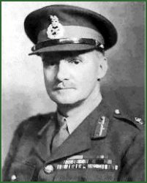
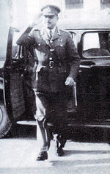
History of Pakistan Army
General Sir Frank Messervy
General Sir Douglas Gracey
Field Marshal Ayub Khan
Commander in Chief
1947 - 1948
Chief of General Staff
1948 - 1951
Commander in Chief
1951 - 1958

Slide 11
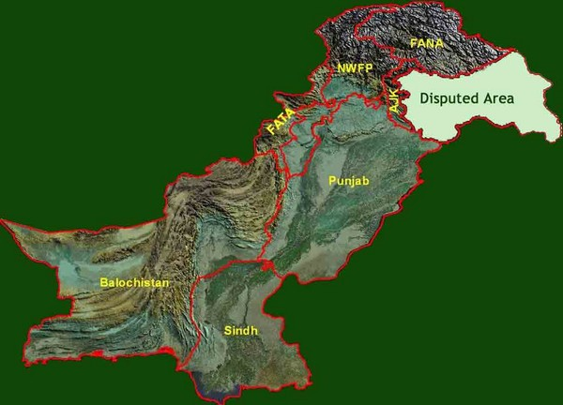
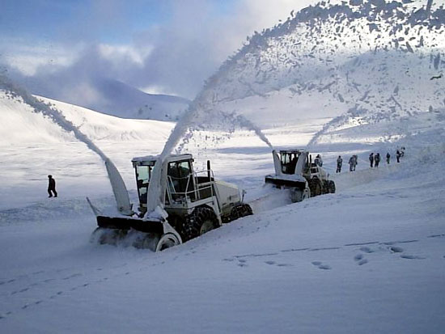
Mission Statement
The Armed Forces shall, under the directions of the Federal Government, defend Pakistan against external aggression or threat of war, and, subject to law, act in aid of civil power when called upon to do so

Slide 12
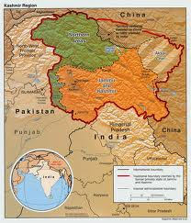
History of Pakistan Army
Pakistan received 6 Armoured, 8 Artillery and 8 Infantry Regiments compared to the 12 Armoured, 40 Artillery and 21 Infantry Regiments that went to India
Pak Army fought 3 maj wars with India
Kashmir war – 1948
Indo Pak War – 1965
Indo Pak War – 1971
Kargil Conflict

Slide 13
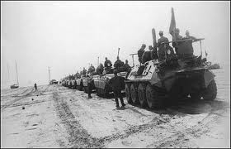
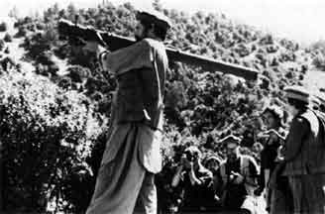
History of Pakistan Army
In the 1980s, Pakistan armed forces supported Afghan Mujahiddins by providing arms, ammunition and intelligence who were fighting Soviet invasion of Afghanistan
The War resulted in successful withdrawal of Soviet forces from Afghanistan

Slide 14
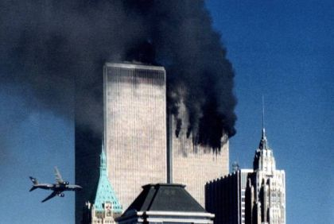
History of Pakistan Army
After 9/11, Pakistan joined War on Terror and successfully flushed the terrorists from Swat and South Wazirstan
Till todate, Pak Army continues to fight the war in overcoming remnants of terrorists in FATA

Slide 15
Role of Armed Forces in Nation Building
Natural Calamities
Floods
Earthquake
Major accidents
Rescue Operations
Wapda Duties
Survey of Schools
Major Construction Work

Slide 16
RANK STRUCTURE

Slide 17
Rank Structure
Ranks and Files
Junior Commissioned Officers
Lance Naik
Naik
Havildar
Naib Subedar
Subedar
Subedar Major

Slide 18
Rank Structure
Officers
2nd Lieutenant
Lieutenant
Captain
Major
Lieutenant Colonel
Colonel
Brigadier
Major General
Lieutenant General
General

Slide 19
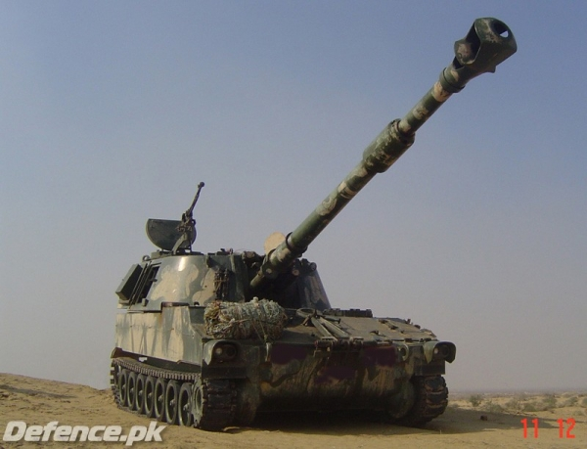
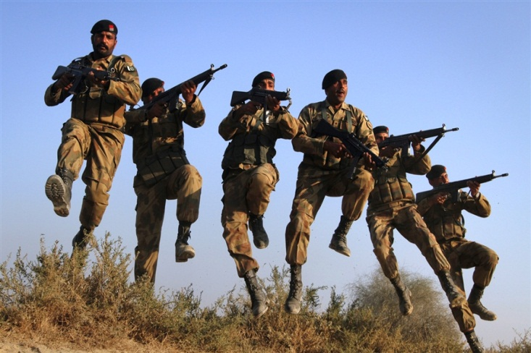
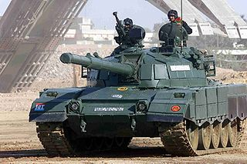
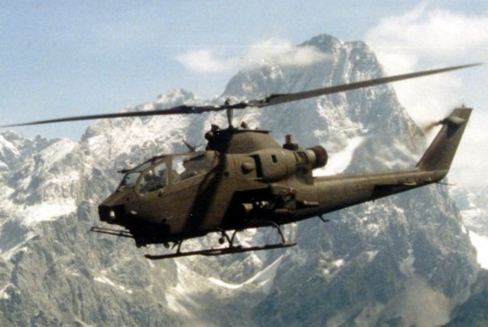
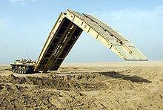
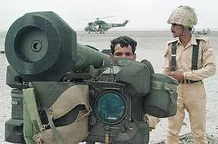
Arms
Artillery
Infantry
Armour
Aviation
Engineers
Air Defence
Signals

Slide 20
Services
Army Services Corps (ASC)
Electrical and Mechanical Engineers (EME)
Army Ordnance Corps
Army Medical Corps
Army Education Corps
Corps of Military Police
Military Intelligence Corps
Army Dental Corps
Remount Veterinary and Farms Corps

Slide 21
Orgs
Several army orgs operate in the commercial sector across the country including:-
National Logistics Cell responsible for tpt of goods across the country
Frontier Works Organization responsible for const
Special Communication Organization for provn of communications in remote areas of Pakistan

Slide 22
Honors and awards

Slide 23
Gallantry Awards
Nishan-e-Haider
Hilal-e-Jurrat
Sitara-e-Jurrat
Tamgha-e-Jurrat
Imtiazi Sanad

Slide 24
Other Awards
Non Operational Awards
Sitara-e-Basalat
Tamgha-e-Basalat
Tamgha-i-Khidmat Class I
Tamgha-i-Khidmat Class II
Tamgha-i-Khidmat Class III
Civil Awards
Nishan-i-Imtiaz
Hilal-i-Imtiaz
Sitara-i-Imtiaz
Tamgha-i-Imtiaz

Slide 25
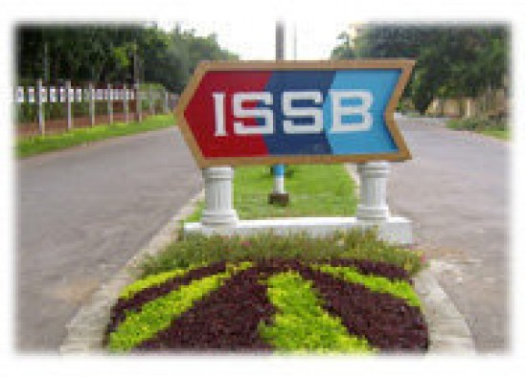
Requirements at issb

Slide 26
Arrival
Before 3 pm on the given date
Normally, candidates who fail to report before 3 pm on the specified date are not allowed to join the tests. However, those reporting an hour or so late due to circumstances beyond their control may be accepted. Such candidates will reach ISSB under their own arrangements
If you report late and are not allowed to appear before the Board, then the Board is not bound to test you on a subsequent date. Likewise, if you fail to report on the specified time and date, ISSB is not be bound to call you again
On arrival day you will report at given time after having your lunch.

Slide 27
Arrival
ISSB Kohat. Due to prevailing security situation, no pick and drop is available at ISSB Kohat and candidates are required to reach ISSB Kohat at their own
ISSB Gujranwala
ISSB Gujranwala is about 7 kms away from Rahwali Check Post on GT Road and 4 kms from Garrison Check Post (MP Check Post 2)
Buses will be available at Garrison MP Check Post
First bus leaves at 1:00 PM
Last bus leaves at 1:45 PM
Private wagons also pass near the ISSB Gujranwala

Slide 28
Arrival
ISSB Malir
It is 5 kms away from Malir Halt Railway Station / Bus Stand and about 15 kms from Karachi Cantt Station
First bus leaves at 1.00 PM
Last Bus leaves at 1.45 PM
This facility is only for out station candidates
Candidates coming from within Karachi may report directly to ISSB Malir Cantt

Slide 29
Boarding and Lodging
You will be provided free messing and lodging at the ISSB. Therefore you need not to bring any bedding
You can have your clothes washed and pressed on payment
Barber’s services are also available
It has been observed that while coming to ISSB many candidates do not take precautionary measures regarding their food and consume eatable from unhygienic places. This carelessness makes them sick and can result into various stomach diseases, which affect their performance at ISSB. You are advised to be more careful regarding your food while traveling to ISSB and refrain eating from low standard sources

Slide 30
Clothing
You are advised to take your clothing according to the prevalent weather as fol:-
Shorts white = 1 Pair
Canvas Shoes / Joggers = 1 Pair
Socks White = 1 Pair
Vest or Sports Shirt White = 1 Pair
Track Suit / Pull-over or Jersey (in winter) = 1 Pair
Above items are also available with ISSB gift shop and canteen, which can be purchased on cash payment

Slide 31
Clothing
Candidates are expected to appear before the Selection Board with a clean and smart posture
In this regard, following dress may be worn during Group Discussion, Group Planning and Interview with proper hair cut and shave:-
Summer: Shalwar Qameez / Shirt and Trousers
Winter: Shalwar Qameez / Lounge Suit / Combination or shirt, Trousers and Pull over / Jersey

Slide 32
Documents Required
You are required to take along the following ORIGINAL documents-
Original Matric certificate issued by board
Detailed marks sheet or Result card of matric
Candidates who have not been issued with Matric Certificate by their concerned board should furnish a certificate signed only by the Secretary Board
Candidates who appear with a “Duplicate” or “Revised” matric certificate or if they have amendments in their names or date of births, should provide certificate explaining the circumstances under which they were issued with “Duplicate” or “Revised” or Amended matric Certificate, signed only by the Secretary Board
The original certificate and marks sheet/result card of Intermediate (FA/FSc, DAE/D.Com/DBA/ICS) is mandatory
Appearing candidates who have completed FA/FSc part-I will bring original part-I marks sheet along with surety/hope certificate

Slide 33
Documents Required
In case of “O”, “A” level, equivalence certificate and birth certificate are compulsory. PHOTOCOPY OF ANY CERTIFICATE WILL NOT BE ACCEPTABLE.
Those candidates who have applied for the courses demanding qualifications higher than intermediate are also required to bring their superior degree/ certificates as mentioned in the concerned course advertisement
Domicile is a must for all those candidates of remote areas, who are eligible to apply on 45% marks in FA/FSc
No plastic coating is allowed on degrees/certificates except those which are already coated and cannot be removed
In case of non-possession of above-mentioned documents you will not be allowed to appear in the test and will be reverted back without paying traveling allowance
Before your arrival, you may contact GSO-2 (Selection) of your concerned ISSB on telephone number mentioned in calling up notices to clarify any doubt about educational certificates

Slide 34
Medical Facilities
The Government of Pakistan will not be responsible to pay any compensation for any injuries sustained during the tests
Every possible medical assistance will, however, be provided free of charge
Seriously ill or injured candidates are treated at military hospitals

Slide 35
Other Facilities
Recreational Facilities
TV, newspapers and facilities for indoor games like Badminton and Table Tennis are available to the candidates
Traveling Allowance
Traveling allowance will be paid to you before departure from ISSB
This is equal to the fare between the place of your residence and ISSB
For this purpose your place of residence will be considered the one, which has been mentioned in your application
For journey performed by road, the allowance will be calculated on the basis of bus fare
If the road journey is shorter than the rail journey the allowance will be paid on the basis of bus fare

Slide 36
Prohibited Items
Camera (all types)
Audio – visual items
Knife / Sharp weapon
Mobile Phone
Pets
Liquors/ Drugs
Fire Arms
Government banned items
Any valuable items
Large sum of money

Slide 37
Miscellaneous
Any attempt by you or by anyone on your behalf in the shape of “SIFARISH”, use of unfair means in Selection Board’s tests or non compliance of Board instructions will debar you for consideration for commission
You are advised not to approach ISSB directly or indirectly, for any favor regarding your selection before or during your tests. Any violation of this may result in your withdrawal
Candidates are not allowed to leave ISSB premises during their stay
Every effort is made to ensure the safety of your belongings. However ISSB will not be responsible for any losses

Slide 38
Miscellaneous
Mobile phones may be brought along however; these will be collected on your arrival at the Reception as mobile phones are not allowed in the premises of ISSB. The same will be returned to you before your departure.
You will be photographed on your arrival. Its expenses plus various other expenses, which are not payable by the government, are charged from candidates on arrival day at the rate of Rs.50/- per head. An extra amount of Rs.10/- will be charged from recalled candidates
Candidates will bring their own utility items like towel and essential toiletries
You should bring your own writing material (blue ball point/ink).
All required items are also available at ISSB Canteen on payment

Slide 39
ISSB TESTS
A PREVIEW

Slide 40
TESTING PROGRAM

Slide 41
Day 1 - Reporting Day
Reception
Checking of Documents
Allotment of Chest Numbers
Candidates are Photographed
Administration Staff’s Address
Writing of Unforgettable Incident on Bio Data Forms

Slide 42
Day 2 - Testing Day
Opening Address by Deputy President
Intelligence Test
Psychological Test

Slide 43
Day 3 - GTO’s Day
Initial Briefing
Group Discussion
Lecturrate
Group Planning
Progressive Group Task
Half Group Task

Slide 44
Day 4 - GTO’s Day
Individual Obstacles
Command Tasks
Final Group Task
Mutual Assessment
Interview (Deputy President)

Slide 45
Day 5 - Conference Day
Conference
Re-interview (if required)
Payment of TA/DA
Departure

Slide 46
Day 1 - REPORTING DAY

Slide 47
Filling up of Bio Data Form
At ISSB after arrival at the selection center, you will be given a bundle of Bio Data forms to fill
Bio Data forms are about your daily life, interests, activities, hobbies, your parents and their occupation, your family and friends
You are required to be sharp while filling the forms
Bio data forms should be filled clean and tidy as they provide interviewer first impression of the candidate

Slide 48
Filling up of Bio Data Form
Bio Data Form is a multi sheet form which requires different personal information regarding you
This form is with the interviewer on the third day of ISSB and he asks questions related to you by reading from it
Caste and Sub-Caste Question
About your Date of Birth and Age
Relatives in Armed Forces
Monthly Income of Parents
Self Description – Some Event in Your Life
THE DATA SHOULD BE FILLED NEATLY AND ACCURATELY

Slide 49
Self Description
The main purpose of this question is to get to know you better, to see your emotional level, to see what kind of things you can bear, and how eventful your life has been, and if the event is life changing, then how has it influenced your life. You may be asked to write about
The most tragic event of your life; may be demise of some close loved one
The unforgettable incident in your life; it can be happy or tragic
The most happiest event in your life
The most shocking event in your life; it can be positive or negative but certainly a positive event is advisable
You may be asked questions related to that event

Slide 50
Day 2 - TESTING DAY

Slide 51
Psychological Tests
These tests include intelligence and personality tests and are held on the morning of the first day
Intelligence Tests; these are of two main types, verbal and written
Mechanical Aptitude Test; designed to assess candidates' basic mechanical sense
Personality Tests; these are written tests of analytical/ projective type and answers provide insight on the personality of the candidate

Slide 52
Fill in the Blanks
Camera is to photographer as __________ is to soldier.
Complete the series:
2, 6, 9, 13, 16, …., ……
Insert the missing letters to form a sensible word:
SK __ TI __ G
What is it that you see once in a MINIUTE, twice in a FORTNIGHT but never in a YEAR or even in the whole LIFE
Abdul is 5 years older to his wife who is 5 times as old as her daughter. If the daughter was 5 years old 3 years back, what is the age of Abdul?

Slide 53
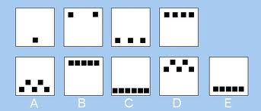
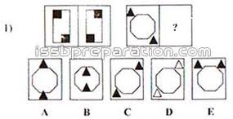
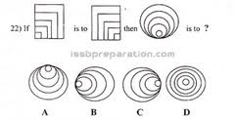
Figure Tests

Slide 54
Mechanical Aptitude Tests
If the wheel rotates as shown, P will
move to the right and stop
move to the left and stop
move to and fro
none of these
Which way does wheel X move?
either
anti-clockwise
clockwise
stays still

Slide 55
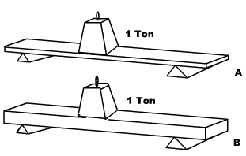
Mechanical Aptitude Tests
Which plank is most likely to break?
A
B
Either

Slide 56
Word Association Test
Love
Atom
Knife
Work
Fortune
Child
Stop
Knowledge
Girl
Flower
Time
Father

Slide 57
Sentence Completion Test
He saw many _________________
His hobby is _________________
This is my _________________
The power of enemy _________________
Pakistani girls are _________________
Pakistani films are _________________
In my leisure time I _________________
Our future lies in _________________
She is not _________________
I Saw a _________________
He has a knife for _________________
His father drank and _________________

Slide 58
Personality Tests
Are you Thinking or Action type?
Are you Objective or Subjective?
Are you Open-Minded or Narrow-Minded?
Have you an Inferiority Complex?
Are you Masculine or Feminine?
Do you Impress People?
Are you Tactful or Tactless?
Do you Feel Secure?

Slide 59
Thematic Appreciation Test
It comprises a series of standard pictures
These pictures are displayed to the candidates one by one
They are required to write a story on every picture
In their story, they have to state what people are doing, what was the reason of the situation and what will be its result

Slide 60
Picture Story Writing

Slide 61
Picture Story Writing

Slide 62
Picture Story Writing

Slide 63
Guidelines for Tests
Personality tests are designed to check the mental agility of the candidates along with other aspects
Try to be as original as possible because it will not be possible to hold on to the concept that conflicts your personality
Completion of the word association tests and sentence completion tests is important
Be positive in attempting psychological tests
Story writing tests your intellectual ability
A story must have a start, a climax and an end
You may like to add few characters but too many of them makes the story complex and difficult to end logically

Slide 64
Day 3 - GTO DAY 1

Slide 65
Group Discussion and Lecturate
Group Discussion
A topic will be given by GTO for discussion by the group
Each candidate is expected to give his opinion on the given topic
Candidates should not repeat the ideas of others and should come up with new ideas
Give chance to others also
Lecturate
After the group Discussion , Lecturrate will be held
Topic will be allotted by the GTO
Each candidate will be given 2 Mins for preparation
Each candidate will speak for 2-3 Mins with choice of language
During speech, donot forget the topic
Avoid verbose and try to talk sense

Slide 66
Sample Topics for Group Discussion
The Evils of Superstition
Look before you Leap
Self Help
No Risk, No gain
Ambition
Technical Education
Science our Mother and Step-Mother
Science in the Modern World
Islam Promotes Science
Islam is the only Religion of Mankind

Slide 67
Sample Topics for Lecturate
Blessings and Evils of Money
Importance of Purdah for Women
Causes of National Decay
Flattery
Need of Islamic Education
Obligation of Jehad in Islam
Liberty
Unity
Patriotism
Female Literacy in Pakistan

Slide 68
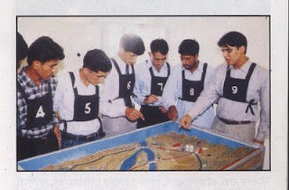
Group Planning
In this test a problem is given on a small model
Candidates are asked to start evolving the plan
15 Mins are given for mutual discussion which will be observed by the GTO
After discussion, candidates are asked to present the plan

Slide 69
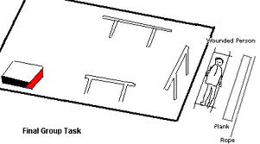
Progressive & Half Group Tests
Group tasks are conducted in which candidates are presented practical situation and left to solve these
Normally these comprise obstacles over which the group is required to plan and carry objects of sufficient bulk and weight to a given point

Slide 70
Day 4 - GTO DAY 2

Slide 71
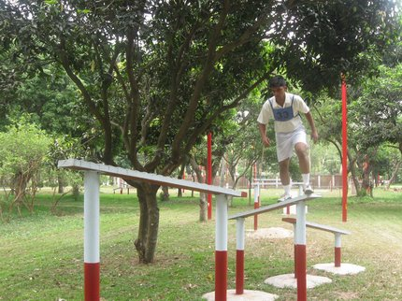
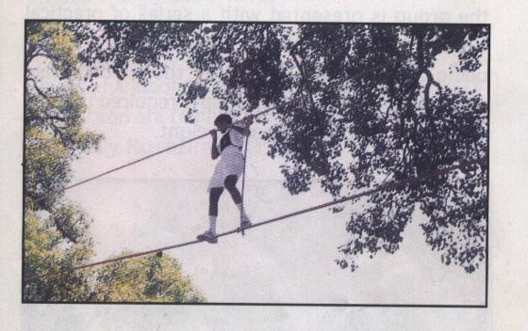
Individual Obstacles
Candidates are asked to negotiate following obstacles:-
Tyre
High Jump
Ditch
Zig Zag
Double Boxing Ring
Tarzan Swing
Monkey Bridge
Hangman’s Rope
Hanging Log

Slide 72
Individual Obstacles
Guidelines
Obstacles are easy for an average physically fit person
Make a plan and then attempt
If stuck up at one obstacle, try it twice and then move to the other
Every candidate is expected to attempt at least 7 obstacles
Use your head rather muscles while negotiating the obstacles
No one has ever died while attempting the obstacles
Consider them as adventure rather than test

Slide 73
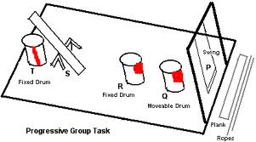
Command Tasks
Each candidate is in turn appointed the commander of the group and given a practical task requiring team work

Slide 74
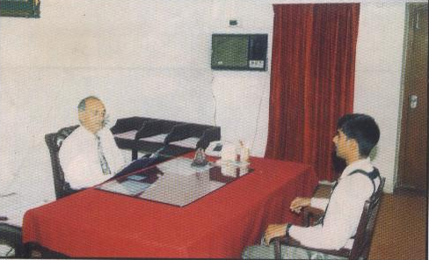
Interviews
Interviewer assesses the candidates in an informal and objective manner
The questions would mainly pertain to the candidate's life, academics, awareness and general aspects requiring the candidates' views

Slide 75
Interviews
Just don’t worry if you feel butterflies fluttering in your stomach. Same happens to everyone while going for the interview
Start is important to make you comfortable
National and international affairs should be seen in detail
General knowledge is a vast subject but you should be at least current with the world affairs that are more relevant today
Problems faced by Pakistan
War on terror and relations with neighbouring countries

Slide 76
Interviews
Likely Questions
What motivated you to join the Army?
Cross questions from the data given in the bio data forms
Habbits
Envmt from which the candidate has been brought up
Whom you think is the best in your group
Arithmetic questions; in case you are stuck up your method should be correct

Slide 77
Guidelines

Slide 78
Psychological Tests
Do not try to frame the expressions by taking too long
Time is constrained and you should bring forth the idea that first comes to your mind on seeing the word
This is a test of your acquired knowledge as well as your inbuilt intelligence both of which have matured by now, so be original and honest in solving the tests
Keep the importance of time foremost in your mind

Slide 79
Group Discussions
Carefully listen to the briefing by GTO
Take interest and remain active during the discussion
Understand topic first and then comment on it
Talk with confidence to the whole group looking in the eye of each candidate, and you must not keep looking at the GTO
Don’t be rigid in your ideas, must accept criticism with open mind
Cooperate and give time to others
Do not hesitate or stop even if you are making grammatical mistakes

Slide 80
Lecturette
Topics given for the lecturette are simple and related to day to day matters
You are given two minutes to establish a concept and two minutes to deliver your ideas
Try to understand the topic and develop a logical sequence
Talk relevant and to the point
Qoute facts and figures to add weight to your talk

Slide 81
Group Planning Tasks
You must strive for winning the distinction of being the leader of the group
You must examine the narrative and try to catch the importance of the matter in your mind before presenting your solution to the group members
If your given judgment appears to be wrong, then you must admit it cheerfully and quickly
Listen to the GTO like a story and remain attentive. Too many details are given in a lesser time. A moment of distraction can put you in back burner
Limitations should be kept in mind
When one is presenting the plan, you should not go in hibernation
Most important - See the whole task till the end

Slide 82
Command Task
As a commander you may take suggestions from your comrades but don’t become their slave
You should not hesitate from helping the group when it is time of need
Standing like a commander and just giving the orders is not desired out of a leader; key point is – LEAD FROM THE FRONT
Occupy the pivotal position in a manner that helps him supervise the task and to be at the critical place without difficulty at the time of need
If you are not the leader, cooperate with others and give your honest opinion
Never remain in the background

Slide 83
Individual Obstacles
Do not try to attempt the obstacles in haste
The time can be best saved by speeding up while running between the obstacles
Make a plan and follow the obstacles in a sequence
Feel confident and calm while attempting the obstacles

Slide 84
Interview
Neat, decent and formal dress up
Use appropriate colours / combination of your dress
Trimmed haircut / shave
Don’t be afraid of Interviewer and speak in natural way
Don’t bluff and don’t be rude
Take due care of non-verbal communication i.e. your body language
Look at the examiner in the face without staring
Do not move your hands impatiently
Do not show off

Slide 85
Interview

Slide 86
A Small Story ‘Building Your House’

Slide 87
This is a tale of three young men who went on a journey through life. The adventures they shared and the lessons of life they learned
Mike, Mark and Jack were three young men who hung out together in "No Goal Arcade." Life was pretty much humdrum and activities they engaged in were far from exciting. As they hung out wasting time, they often peered out the window to the top of the mountain just outside the Arcade doors. The mountain was named Mount Destiny
One day they decided to head out and climb the mountain. Without thought, they started hiking. They got to a dead end after few hours of journey. Not knowing what to do they headed back to No Goal Arcade and named that place as "Dead End.“
Days past, even weeks and every day the mountain seemed to be calling them. They started talking to everyone about their dream of climbing Mount Destiny. And turned their dream into a goal. They planned, prepared and day came when they were ready to leave. They said farewell to their many "going nowhere friends" at No Goal Arcade and off they went…

Slide 88
Weather cooperated first couple days but then the wind and rain started. Every step got heavier and the progress they made each hour became next to nil. They made camp, and frustrated they climbed into their sleeping bags and went to sleep
In the morning the sun broke through the clouds and Mike and Mark were excited to get going. Jack however was nowhere to be found. Where his sleeping bag had been the night before was a note. "Guys, I'm going back to the arcade to my old friends. This climb is too much work and the weather is a pain. You can go on without me or you can join me back at the Arcade.”
Mike and Mark were disappointed, however they were not detoured from their goal. The mountain peak was still there to conquer. The climb continued to be more difficult than they expected and Mark was getting weary. They cleared another rise in the terrain and before them was a beautiful valley. Fish were jumping in the lake and wild life was all around them. The valley, according to the map, was called "Good Enough Valley."

Slide 89
They made camp and decided to take it easy a few days. Finally after just a few days Mike got restless. He informed Mark that in the morning they would break camp and carry on. Mark however said he was satisfied in "Good Enough Valley” and had no intention of pushing any further. Good Enough Valley was good enough for him.
Mike went on alone. He climbed some of the most difficult rock walls, went around some huge boulders. Bleeding from both his knees and grabbing onto rocks with cold scraped fingers, he kept going without the thought of turning back. He was determined to make it to the top, and that is exactly what he did
Years later Mike, Mark and Jack met in a place called the here after. Mark and Jack went to Mike and asked him to tell them about the rest of the journey up to the Mount Destiny
Mike smiled and said - Friends it is not the journey that really mattered, it is what I learned along the way. When we were all hanging out at No Goal Arcade we had no dreams and thus no goals. I know now one needs to have a dream and make that dream a goal and also dream BIG

Slide 90
Then, when we hit dead end canyon, the first time we attempted the climb. From that experience I learned "If you fail to plan, you plan to fail."
The second time we set out we had both a goal and a plan, but Jack you never understood that "when the going gets tough, the tough get going.“
Mark - we had fun in Good Enough Valley didn't we? But you stayed there and never finished the climb. From watching you I learned that "if you settle for second best that is all you will ever be or have."
I went on alone through the hardest part of the climb. It was clear to me that "Quitters Never Win and Winners Never Quit," and by choice I chosed to win and so I did. But now that we are here, there is still one more lesson I learned that is very powerful. "There is Never a End to Learning, Only New Beginnings."
With that statement he turned to his two friends from another time and said with the confidence of the old man...... "Lets begin"

Slide 93
Have Faith in Allah

Slide 94
Thank You

